Slide 1
REQUIREMENTS ENGINEERING

Slide 2
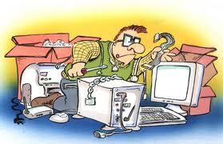
Requirements Specification

Slide 3
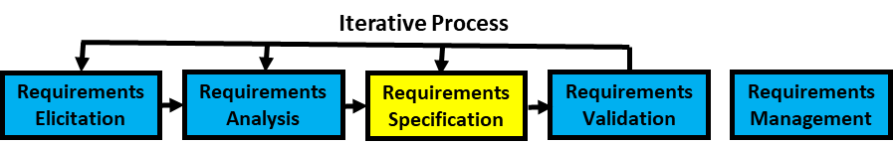

Requirements Specification
Once requirements are elicited .. analyzed .. we then specify those requirements..
Requirements specification is the documentation of a set of requirements that is reviewed and approved by the customer and provides direction for the software construction activities in the next stage of the life cycle
The software requirements specification (SRS) document is the basis for customers and contractors/suppliers agreeing on what the product will and will not do. It describes both the functional and nonfunctional requirements

Slide 4
Documentation Characteristics
Reasons for documentation:
Visibility (e.g. needed for project plan)
Formalization leads to better clarity when expressed in writing
User support (e.g., user manual)
Team communication (e.g. interface specifications, global teams)
Maintenance and evolution (e.g., requirements and easier control)
Characteristics of documentation:
Accurate and kept current
Appropriate for audience
Maintained online (usually)
Simple but professional in style and appearance

Slide 5
Requirements Specification
Non
Functionality

Slide 6
Software Requirements Specification (SRS)
Functionality: What is the software supposed to do?
External interfaces. How does the software interact with people, the system’s hardware, other hardware, and other software?
Non Functionality. This includes all of the Quality criteria's which drive the functionality. These could be
Performance - What is the speed, response time, recovery time, etc., of various software functions?
Other Quality Attributes like Availability, Portability, correctness, maintainability, etc.
Design constraints imposed on an implementation
required standards in effect
implementation language
policies for database integrity
resource limits
security
operating environment(s) etc.?

Slide 7
Software Requirements Specification (SRS)
ToC recommended by IEEE for SRS (IEEE Std. 830-1998)
1. Introduction
1.1 Purpose
1.2 Scope
1.3 Definitions, acronyms, and abbreviations
1.4 References
1.5 Overview
2. Overall description
2.1 Product perspective
2.2 Product functions
2.3 User characteristics
2.4 Constraints
2.5 Assumptions and dependencies
3. Specific requirements
3.1 External Interface
3.2 Functional Requirements
3.3 Non-Functional Requirements
3.4 Design Constraints
Appendixes
Index
Illustration

Slide 8
Requirements Validation
Iterative Process
Requirements Elicitation
Requirements Analysis
Requirements Specification
Requirements Validation
Requirements Management
The purpose of requirements is to help ensure that the requirements does what the customer wants
This is an important phase because repairing requirement errors in downstream phases can be expensive
Validation and Verification
Validation determines whether the software requirements if implemented, will solve the right problem and satisfy the intended user needs
Verification determines whether the requirements have been specified correctly
(Reviews are used for both validation and verification)

Slide 9
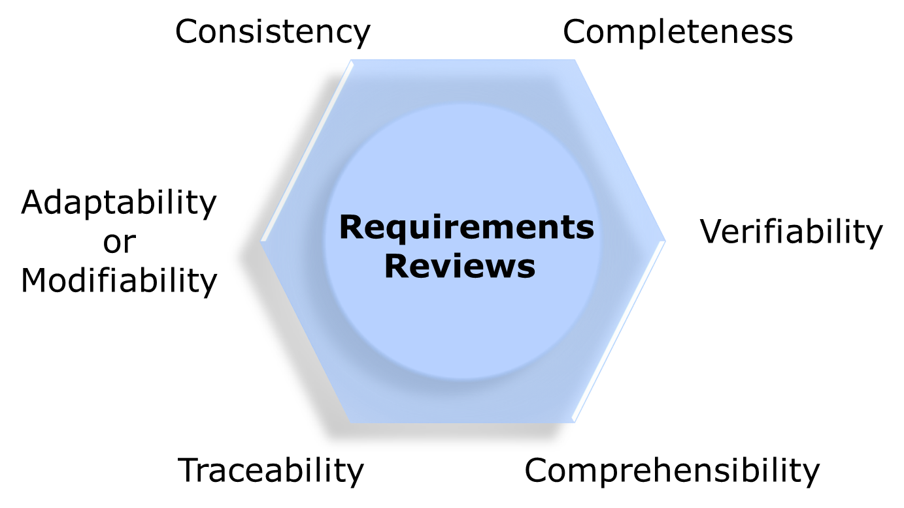
Requirements Validation
Iterative Process
Requirements Elicitation
Requirements Analysis
Requirements Specification
Requirements Validation
Requirements Management
Requirement Reviews

Slide 10
Requirements Validation
Iterative Process
Requirements Elicitation
Requirements Analysis
Requirements Specification
Requirements Validation
Requirements Management
Prototyping
Prototype facilitates user involvement during requirements engineering phase and ensures engineers and users have the same interpretation of the requirements
Prototyping is most beneficial in systems
that will have many user interactions
Example - design of online billing systems where the use of screen dialogs is extensive
Systems with little or no user interaction may not benefit as much from prototyping
such as batch processing or systems that mostly do calculations

Slide 11
Requirements Validation
Iterative Process
Requirements Elicitation
Requirements Analysis
Requirements Specification
Requirements Validation
Requirements Management
Model Validation
Ensuring that the models represent all essential functional requirements These could be Use Case or other models
Demonstrating that each model is consistent in itself
Example : Flow diagrams, class models and static analysis, verify for existence of proper communication paths to facilitate data exchange
Usage of the Fish Bone Analysis technique to validate if the requirements identified is addressing the reasons needing the solution to the problem which had led to the requirements
Acceptance Criteria
Using Acceptance criteria’s to see if there are requirements matching with that the Acceptance criteria

Slide 12
Requirements Management
Iterative Process
Requirements Elicitation
Requirements Analysis
Requirements Specification
Requirements Validation
Requirements Management
Requirements specification is the baseline on which the future lifecycle phases will need to build upon
Requirements can change due to
Better understanding of the problem
Customer internalizing the problem and solution
Evolving environment and technology landscape
Requirements management has two facets
Ensuring that the requirements are all addressed in each phases of the lifecycle
Ensuring that the changes in the requirements are handled appropriately

Slide 13
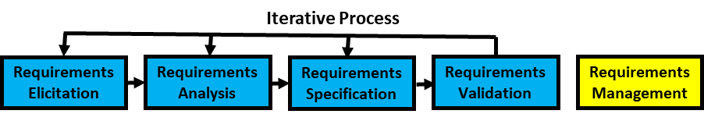
Requirements Traceability Matrix - RTM
Req Id | Architectural Section | Design Section | File/ Implementation | Unit Test Id | Functional Test ID | System Test ID | Acceptance Test Id
Requirements identification – This could be a number like FR-1/NF-1 or a unique use case reference UC-1, goal-hierarchy numbering along with version information etc.)
Every phase of the SDLC progressively fills the RTM
Requirements are traced across the SDLC using the requirement traceability matrix (RTM)
Forward Tracing
Backward Tracing

Slide 14
Requirements Change Management
Iterative Process
Requirements Elicitation
Requirements Analysis
Requirements Specification
Requirements Validation
Requirements Management
Reiterating, number of things can change in the environment during the development … leading to change in Requirements
Change in the requirements have impacts on plans, work products etc.
Uncontrolled changes can have a huge adverse impact on project in terms of cost, schedule, quality and expectations
Changes have to be allowed, but in a controlled manner or in other words has to be managed
In the perspective of managing the changes, change requests go through a formal change management process as in the subsequent slides

Slide 15
Requirements Change Process
Iterative Process
Requirements Elicitation
Requirements Analysis
Requirements Specification
Requirements Validation
Requirements Management
Log the request for change and assign a change request Identifier
Log
Who is requesting for the change
Why is the request coming in
What is being requested to change
Perform impact analysis on the work products and items
Estimate impact on scope, effort and schedule (may be quality)
Review impact with stakeholders
Solicit Formal Approval as part of the approval process
Rework the work products/items
Log the following post changes
When was it changed
Who all made changes
Who reviewed the changes
Who tested the changes
Which release stream is the change going to be part of

Slide 16

Requirements Change Management
Iterative Process
Requirements Elicitation
Requirements Analysis
Requirements Specification
Requirements Validation
Requirements Management
Change Control
Impact of change at specific phases
Responding to change requests
Traceability
Links between user requirement, architecture design, implementation, testing of all system components
Record approved changes
Communicate changes
Status Tracking
Pending
Approved
Rejected
Deferred
Validated
Completed
Cancelled
Version Control
New document versions

